Slide 1
Learning Objective
To learn how to register for the SAT.
Agenda:
1. Announcements
2. SAT Registration

Slide 2
This Week’s Announcements
Weds. Feb. 10th Early Release
Monday, Feb. 15- BISD Holiday, but not for ACC
PSAT scores should be available in March

Slide 3
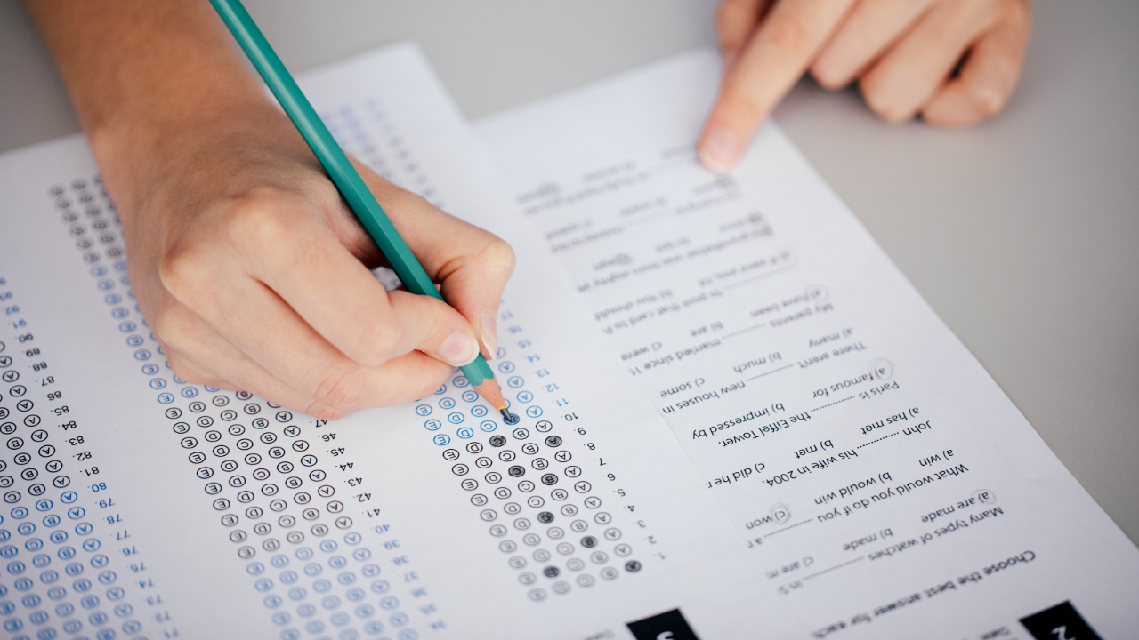
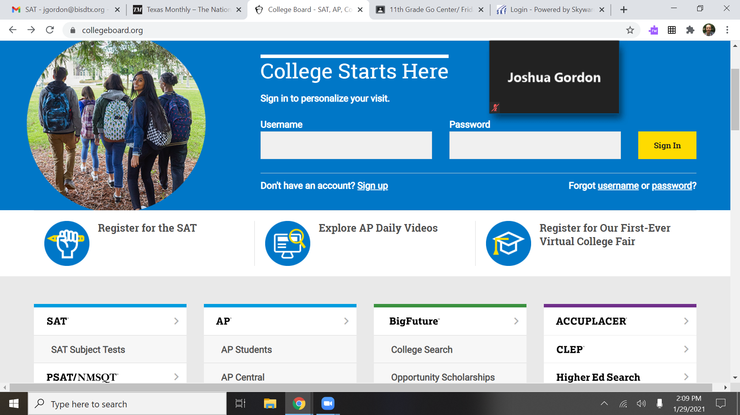
SAT registration
Go to Collegeboard.org, click register for SAT, and then sign in. Begin filling out the required information.

Slide 4
SAT Basics
You should plan on taking the SAT at least once this semester.
The SAT can be taken at either BHS or CCHS on May 8th or June 5th
If you receive free or reduced lunch, you are eligible for a SAT Fee Waiver. The fee waiver allows you to take two SATs for free for both your Junior and Senior years and apply for college for free. Contact Mr. Gordon if you need one.
What score do I need? There is no one answer to this question. It depends on which universities you are applying to and what majors. See Mr. Gordon for more info.

